Slide 1
NP-Completeness
Session 21
Henry Lucky, S.Kom. M.Kom.

Slide 2
Outline Materials
Session 21
NP-Completeness
Polynomial time
Polynomial time verification
Reduction method

Slide 3
Learning outcomes
21
LO 1: Explain fundamental concept of analysis algorithms
LO 2: Apply algorithm techniques and methods
LO 3: Solve a problem using specific algorithm.
LO 4: Compare several algorithm design methods

Slide 4
NP-Completeness
Introduction
So far, we’ve seen a lot of good news!
Such-and-such a problem can be solved quickly (i.e., in close to linear time, or at least a time that is some small polynomial function of the input size)
NP-completeness is a form of bad news!
Evidence that many important problems can not be solved quickly.
NP-complete problems really come up all the time!

Slide 5
NP-Completeness
Introduction
Knowing that they are hard lets you stop beating your head against a wall trying to solve them…
Use a heuristic: come up with a method for solving a reasonable fraction of the common cases.
Solve approximately: come up with a solution that you can prove that is close to right.
Use an exponential time solution: if you really have to solve the problem exactly and stop worrying about finding a better solution.

Slide 6
NP-Completeness
Decision problems vs optimization problem
Decision problems
Given an input and a question regarding a problem, determine if the answer is yes or no
Optimization problems
Find a solution with the “best” value
NP- completeness applies directly not to optimization problems, however, but to decision problems
Optimization problems can be cast as decision problems that are easier to study
E.g.: Shortest path: G = unweighted directed graph
Find a path between u and v that uses the fewest edges (Optimization)
Does a path exist from u to v consisting of at most k edges? (Decision)

Slide 7
NP-Completeness
Classes of problems
Class P consists of (decision) problems that are solvable in polynomial time
Polynomial-time algorithms
Worst-case running time is O(n^{k}), for some constant k
Examples of polynomial time:
O(n²), O(n³), O(1), O(n lg n)
Examples of non-polynomial time:
O(2^{n}), O(n^{n}), O(n!)

Slide 8
NP-Completeness
Classes of problems
Problems in P (can be solved in polynomial time) are also called tractable (easy)
Problems not in P (require super polynomial time) are intractable (hard)
Can be solved in reasonable time only for small inputs
Or, can not be solved at all
Are non-polynomial algorithms always worst than polynomial algorithms?
- n^{1,000,000} is technically tractable, but really impossible
- n^{log log log n} is technically intractable, but easy

Slide 9
NP-Completeness
Classes of problems
NP can be classified in various categories based on their degree of difficulty, e.g.,
NP
NP-hard
NP-complete
Let’s define NP algorithms and NP problems …

Slide 10
NP-Completeness
NP Algorithms
Nondeterministic algorithm = two stage procedure:
Nondeterministic (“guessing”) stage:
generate randomly an arbitrary string that can be thought of as a candidate solution (“certificate”)
Deterministic (“verification”) stage:
take the certificate and the instance to the problem and returns YES if the certificate represents a solution
NP algorithms (Nondeterministic polynomial)
verification stage is polynomial

Slide 11
NP-Completeness
NP Algorithms
Class NP consists of problems that could be solved by NP algorithms
i.e., verifiable in polynomial time
Verifiable? If we were given a “certificate” (the solution to a problem and an instance of the problem), we could verify that the certificate is correct in polynomial time.
Warning: NP does not mean “non-polynomial”

Slide 12
NP-Completeness
NP Algorithms: Certificate
Example of Certificate:
For 0/1 Knapsack problem, we can cast it to a decision problem variant as "Is it possible to fill the Knapsack to within k pound or less of its capacity?”. Then, the certificate would be the list of item weights that adds up to some number less than or equal to capacity, but not less by more than k.
For shortest path problem, we can cast it to a decision problem variant as “Does a path exist from u to v consisting of at most k edges?”. Then, the certificate would be the actual path with at most k edges.
The point is, certificate is used to easily verify that the answer to the decision problem is yes.

Slide 13
NP-Completeness
P vs np
P
Any problem in P is also in NP:
P ⊆ NP
The big (and open question) is whether NP ⊆ P or P = NP
i.e., if it is always easy to check a solution, should it also be easy to find a solution?
Most computer scientists believe that this is false but we do not have a proof
As a matter of fact, this so-called P vs NP problem has been one of the deepest, most perplexing open research problems in theoretical computer science since it was first posed in 1971!
NP

Slide 14
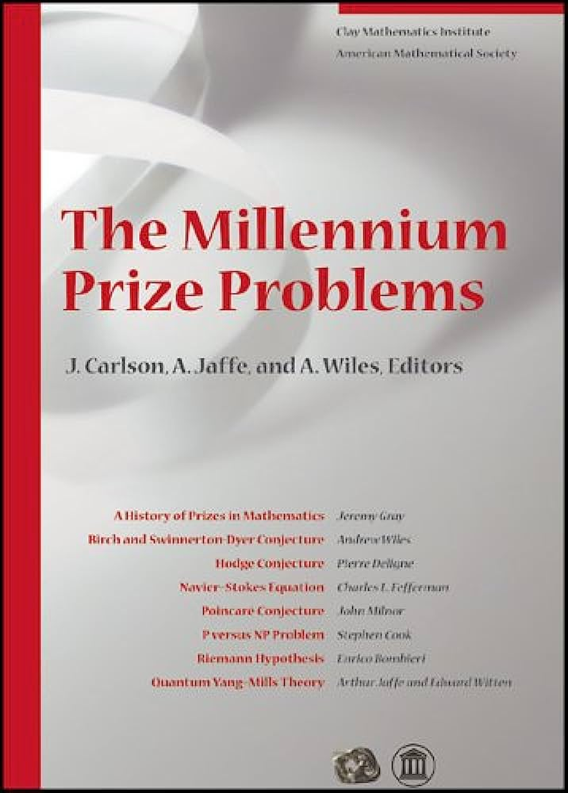
NP-Completeness
P vs np
P vs NP problem is one of the seven well-known complex mathematical problems selected by the Clay Mathematics Institute in 2000, called the Millennium Prize Problems
The Clay Institute has pledged a US$1 million prize for the first correct solution to each problem.

Slide 15
NP-Completeness
NP-Complete problem
A problem belongs to the class NP-complete if it belongs to NP and is as “hard” as any problem in NP. (We’ll define “hard” later)
If any NP-complete problem can be solved in polynomial time, then every problem in NP has a polynomial-time algorithm.
Most theoretical computer scientist believe that NP-complete problem are intractable.

Slide 16
NP-Completeness
NP-complete problem
Yet, given the effort devoted thus far to proving that NP-complete problems are intractable (without a conclusive outcome), we cannot rule out the possibility that the NP-complete problems could turn out to be solvable in polynomial time.

Slide 17
Polynomial time
Abstract problems
We define an abstract problem Q to be a binary relation on a set I of problem instances and a set S of problem solutions.
For example, an instance for SHORTEST-PATH is a triple consisting of a graph and two vertices.
A solution is a sequence of vertices in the graph, with perhaps the empty sequence denoting that no path exists.

Slide 18
Polynomial time
Abstract problems
NP-Completeness restricts attention to decision problems.
So, we can view an abstract decision problem as a function that maps the instance set I to the solution set {0, 1}
For example, a decision problem related to SHORTEST-PATH is the problem PATH that we saw earlier.
If I = (G, u, v, k) is an instance of PATH, then PATH(i) = 1 (yes) if G contains a path from u to v with at most k edges, and PATH(i) = 0 otherwise.

Slide 19
Polynomial time
Encodings
Encodings
If we want to talk about problems being solved by a machine,
then we should specify them so that the machine can understand them
➔ encode input as bit string
Does it matter how we encode exactly?
yes, for certain special problems and “stupid” encodings
no, as long as we use “reasonable” encodings

Slide 20

Polynomial time
Formal Language framework
An alphabet $∑$ is a finite set of symbols.
A language $L$over $∑$ is any set of strings made up of symbols from $∑$.
For example, if $∑ =\{0,1\}$, the set $L=\{11, 101, 111, 1011, 1101, …\}$ is the language of binary representations of prime numbers.
We denote the empty string by $ε$, the empty language by $∅$, and the language of all strings over $∑$by $∑^{∗}$.
For example, if $∑ =\{0,1\}$, then $∑^{∗}=\{ε, 0, 1, 00, 01, 10, 11, 000, …\}$ is the set of all binary strings.

Slide 21

Polynomial time
Formal Language framework
For example, the decision problem PATH has the corresponding language:
$$PATH=\{\left\langle G, u, v, k\right\rangle : G=\left(V, E\right) is an undirected graph$$
$$u, v ∈V,$$
$$k≥0 is an integer, and$$
$$G contains a path from u to v with at most k edges\}$$
The formal-language framework allows us to express concisely the relation between decision problems and algorithms that solve them.

Slide 22

Polynomial time
Formal language framework
We say that an algorithm A accepts a string $x∈{\left\{0,1\right\}}^{∗}$if, given input x, the algorithm’s output A(x) is 1.
The language accepted by algorithm A is a set of strings $L=\{x∈{\left\{0,1\right\}}^{∗} :A\left(x\right)=1\}$, that is, the set of strings that the algorithm accepts.
An algorithm rejects a string if A(x) = 0.
Using this framework, we can provide an alternative definition of the complexity class P:
$$P=\{L⊆{\left\{0,1\right\}}^{∗} :there exists an algorithm A that decides L in polynomial time\}$$

Slide 23

Polynomial time verification
Introduction
Now, let’s look at algorithms that verify membership in languages.
For example, suppose that for a given instance $\left\langle G, u, v, k\right\rangle$ of the decision problem PATH, you are also given a path p from u to v.
You can check whether p is a path in G and whether the length of p is at most k, and if so, you can view p as a “certificate” that the instance indeed belongs to PATH.
For the decision problem PATH, this certificate doesn’t seem to buy much.
After all, PATH belongs to P (can be solved in polynomial time using Dijkstra)

Slide 24

Polynomial time verification
Hamiltonian cycle
Hamiltonian Cycle
Input: undirected graph G=(V,E)
Question: Does a graph G have a Hamiltonian cycle? (Hamiltonian cycle = cycle visiting every vertex in V exactly once)
Formal language:
$$HAMCYCLE=\{\left\langle G\right\rangle :G is a hamiltonian graph\}$$

Slide 25

Polynomial time verification
Hamiltonian cycle
Let’s say that G is encoded as its adjacency matrix.
If the adjacency matrix contains n entries, so that the length of the encoding of G equals n, then the number m of vertices in the graph is $Ω(\sqrt{n})$. (More than equal to $\sqrt{n}$)
For example:
$$G=\left(\begin{matrix}0 & 2 & 0 \\ 2 & 0 & 1 \\ 0 & 1 & 0\end{matrix}\right)$$
Will have graph such as:
2
1
A
B
C

Slide 26

Polynomial time verification
Hamiltonian cycle
There are m! possible permutations of the vertices, because we have to check every single permutation possible to find the cycle.
Therefore, the running time is $Ω\left(m!\right)=Ω\left(\sqrt{n}!\right)=Ω(2^{\sqrt{n}})$, which is not $O(n^{k})$ for any constant k.
Thus, this naive algorithm does not run in polynomial time.

Slide 27

Polynomial time verification
Verification algorithms
Suppose that a friend tells you that a given graph G is hamiltonian, and then the friend offers to prove it by giving you the vertices in order along the hamiltonian cycle (certificate).
It would certainly be easy enough to verify the proof:
simply verify that the provided cycle is hamiltonian by checking whether it is a permutation of the vertices of V (simply sort 2 lists and check if the value is same for every position, runs in $O(m^{2})$), and
whether each of the consecutive edges along the cycle actually exists in the graph (can do double nested loop for every vertex and check, which runs in $O(m^{2})$).
Thus, this verification algorithm can run in $O(m^{2})$, which also $O(n)$, where n is the length of the encoding of G.

Slide 28

Polynomial time verification
Verification algorithms
You could certainly implement this verification algorithm to run, even in $O(n^{2})$ time.
Thus, a proof that a hamiltonian cycle exists in a graph can be verified in polynomial time.

Slide 29

Polynomial time verification
Verification algorithms
We define a verification algorithm as being a two-argument algorithm A, where one argument is an ordinary input string x and the other is a binary string y called a certificate.
A two-argument algorithm A verifies an input string if there exists a certificate y such that A(x, y)=1.
The language verified by a verification algorithm is
$$L=\{x∈{\left\{0,1\right\}}^{∗} :there exists y∈{\left\{0,1\right\}}^{∗} such that A\left(x,y\right)=1\}$$

Slide 30

Polynomial time verification
Complexity class NP
Complexity class NP is the class of languages that can be verified by a polynomial time algorithm.
More precisely, a language L belongs to class NP if and only if there exist a two-input polynomial time algorithm A and a constant c such that:
$$L=\{x∈{\left\{0,1\right\}}^{∗} :there exists a certificate y with \left|y\right|=O\left({\left|x\right|}^{c}\right)$$
$$such that A\left(x,y\right)=1\}$$
Algorithm A verifies language L in polynomial time

Slide 31

Polynomial time verification
Complexity class NP
You can see that $HAM−CYCLE∈NP$.
If $L∈P$, then $L∈NP$, since the algorithm can be converted to a two argument verification algorithm that simply ignores any certificate and accept the input string.
Thus, $P⊆NP$.

Slide 32
Reduction method
Reduction is a way of saying that one problem is “easier” than another.
We say that problem A is easier than problem B, (i.e., we write “A ≤ B”) if we can solve A using the algorithm that solves B.
Idea: transform the inputs of A to inputs of B

Slide 33
Reduction Method
Given two problems A, B, we say that A is polynomially reducible to B (A ≤_{p} B) if:
There exists a function f that converts (transform) the input of A to inputs of B in polynomial time
The answers are the same, i.e A(i) = YES ⇔ B(f(i)) = YES

Slide 34
Reduction Method
Polynomial time algorithm to decide A
yes
α
f
β
Polynomial time
algorithm to decide B
yes
no
no
To solve problem A in polynomial time:
Use a polynomial time reduction algorithm (f) to transform A into B
Run a known polynomial time algorithm for B
Use the answer for B as the answer for A

Slide 35

Reduction Method
Now we can properly define the set of NP-complete languages:
A language $L⊆{\{0,1\}}^{∗}$ is NP-complete if:
$L∈NP$, and
$L^{′}≤_{p}L for every L^{′}∈NP$
If language L satisfies property 2, but not necessarily property 1, we say that L is NP-hard.

Slide 36
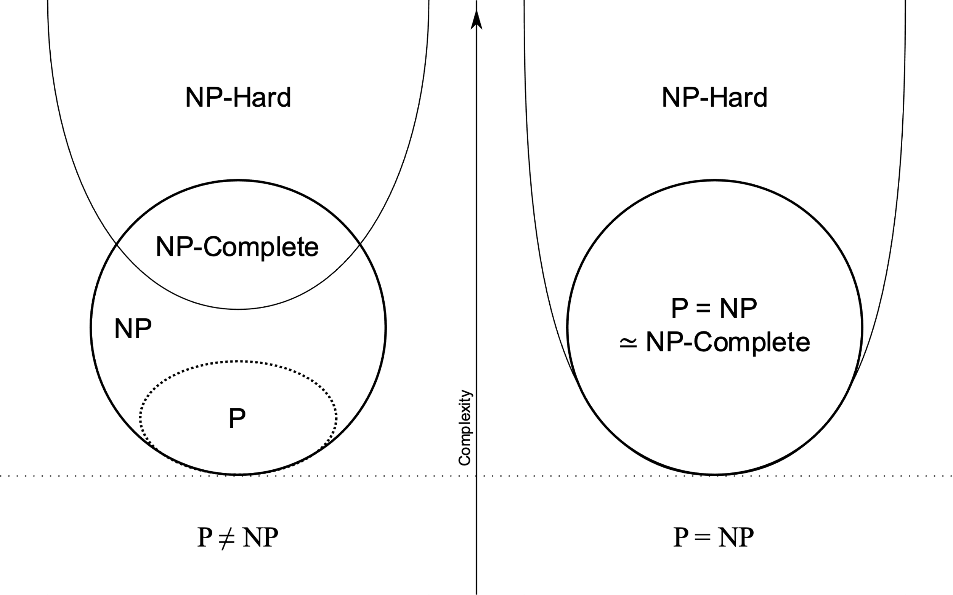
Reduction Method
This is the relationship for P, NP, NP-Hard and NP-Complete

Slide 37
Reduction Method
From previous diagram, we can infer that a problem is called NP-Complete if it is NP and also NP-Hard.
To prove that the problem L is in NP, just make a verification algorithm that runs in polynomial.
To prove that the problem L is in NP-Hard, we need to reduce another NP-Hard Problem L’ to solve problem L.
So, if we need another NP-Hard problem to prove another NP-Hard problem, then there should be a first NP-Hard problem to prove all other NP Problems.

Slide 38
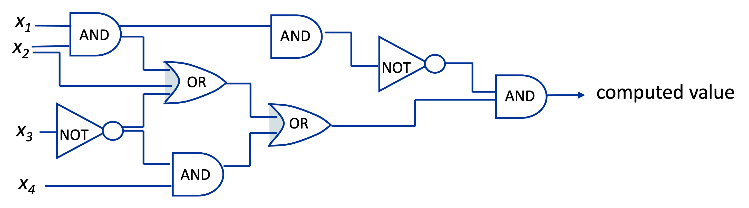
Reduction Method
A First NP-complete problem
Circuit-SAT (circuit-satisfiability)
Input: Boolean combinatorial circuit
Question: Can input variables be set such that circuit evaluates the output to true (1)?

Slide 39
Reduction Method
Proving NP-Completeness of other problems
Theorem: If problem A is NP-hard and problem A ≤_{P} problem B,
then problem B is also NP-hard.
General strategy to prove that a problem B is NP-complete
Select problem A that is known to be NP-complete.
Prove that A ≤_{P} B:
Describe reduction algorithm, which maps instances x of A to instances f (x) of B.
Prove that x is “yes”-instance for A if f (x) is “yes”-instance for B
Prove that reduction algorithm runs in polynomial time
(Now you have shown that B is NP-hard.)
Prove that B is in NP by giving polynomial-time verification algorithm.

Slide 40
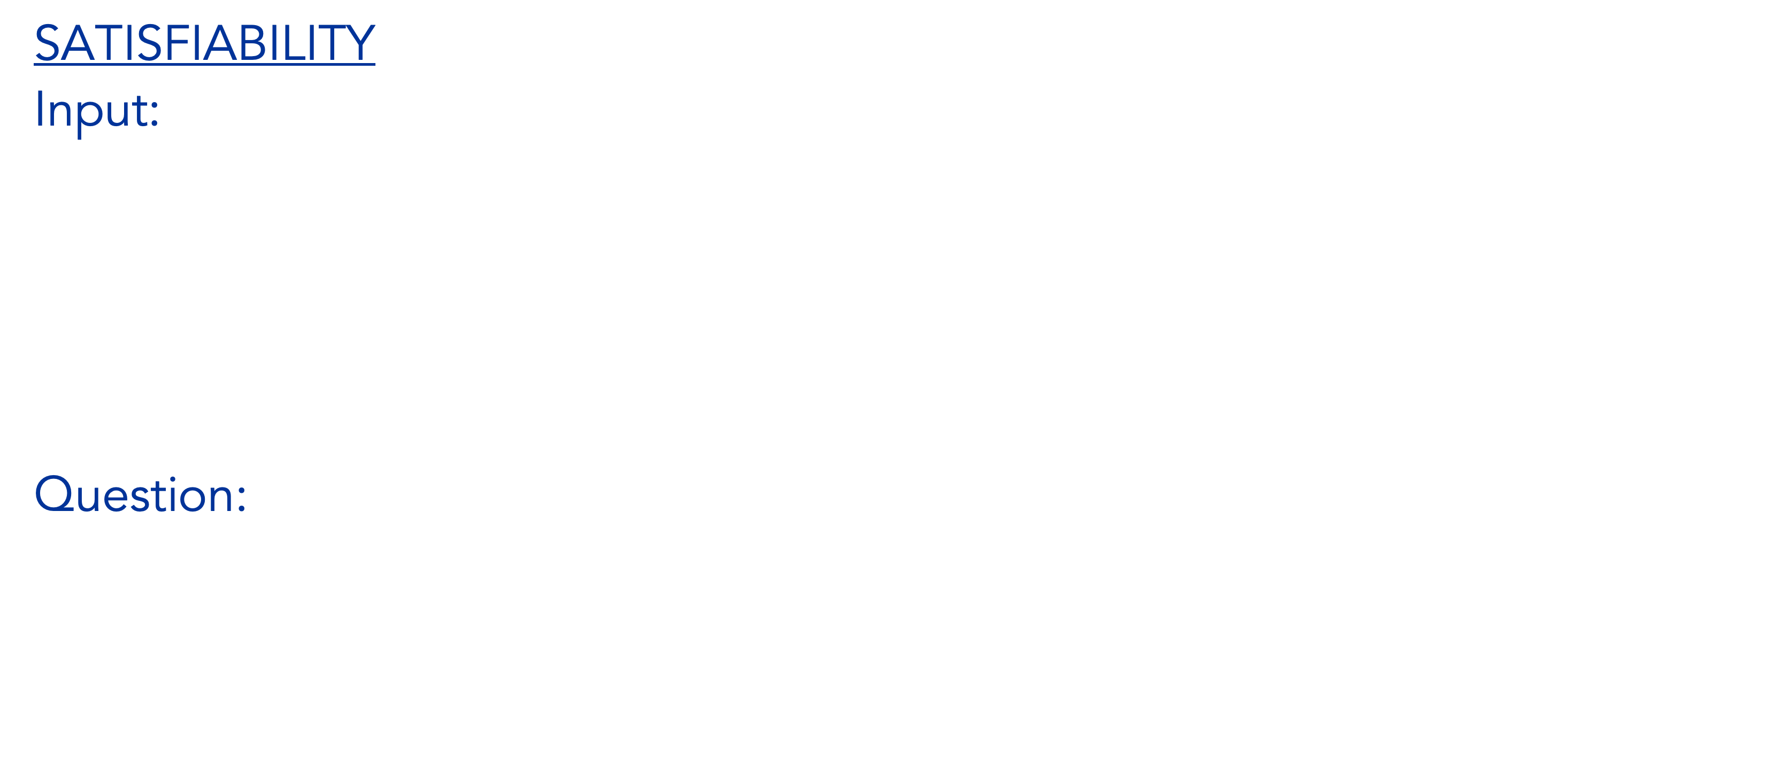
Reduction Method
Proving NP-Completeness of other problems: Example
SATISFIABILITY
Input: A Boolean formula:
n boolean variables: x1, x2, …, xn
m boolean connectives: such as $∧$ (AND), V (OR), ¬ (NOT), → (Implication), if and only if
parentheses
Question: Is the formula satisfiable ?

Slide 41

Reduction Method
Proving NP-Completeness of other problems: Example
For Example:
The formula $f=(x_{1}→x_{2})∨ ¬((¬x_{1}↔ x_{3})∧x_{4})$
Has satisfying assignment $(x_{1}=0, x_{2}=0, x_{3}=1, x_{4}=1)$, since
$$f=(0→0)∨ ¬((¬0↔1)∧1)$$
$$=1∨ ¬((¬0↔1)∧1)$$
$$=1∨ ¬(1∧1)$$
$$=1∨ ¬(1)$$
$$=1∨0=1$$

Slide 42

Reduction Method
Satisfiability
The naïve algorithm does not run in polynomial time.
A formula with n variables has $2^{n}$ possible assignments and the time required to check every possible assignments, which is superpolynomial in n.

Slide 43
Reduction Method
Theorem: SATISFIABILITY is NP-complete.
Proof:
Select known NP-complete problem: Circuit-SAT
Prove that Circuit-SAT ≤_{P} SATISFIABILITY
Describe reduction algorithm, which maps instances x of A to instances f (x) of B.
Prove that x is “yes”-instance for A if f (x) is “yes”-instance for B
Prove that reduction algorithm runs in polynomial time
Prove that SATISFIABILITY is in NP by giving polynomial-time verification algorithm.

Slide 44

Reduction Method
Reduction Algorithm:
Assign variable xi for every wire in the circuit.
For each gate, use this formula to express how it operates:
$$Gate^{′}s output ↔Gate^{′}s inputs function$$
For operation in each gate, add all of them using $∧$
This algorithm is straightforward and can definitely run in polynomial time.

Slide 45
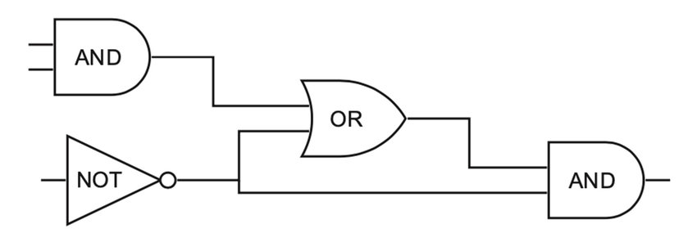

Reduction Method
Given this circuit:
We will have formula:
$$f=x_{7}∧(x_{4}↔(x_{1}∧x_{2}))∧(x_{5}↔¬x_{3})∧(x_{6}↔(x_{4}∨x_{5}))∧(x_{7}↔(x_{5}∧x_{6})))$$
X₁
X₄
X₂
X₆
X₃
X₅
X₇

Slide 46
Reduction Method
If Circuit has a satisfying assignment, then each wire of the circuit has a well-defined value, and the output of the circuit is 1.
Therefore, when wire values are assigned to variables in f, each clause of f evaluates to 1, and thus the conjunction of all evaluates to 1.

Slide 47
Reduction Method
Theorem: SATISFIABILITY is NP-complete.
Proof:
Select known NP-complete problem: Circuit-SAT
Prove that Circuit-SAT ≤_{P} SATISFIABILITY
Describe reduction algorithm, which maps instances x of A to instances f (x) of B.
Prove that x is “yes”-instance for A if f (x) is “yes”-instance for B
Prove that reduction algorithm runs in polynomial time
DONE
Prove that SATISFIABILITY is in NP by giving polynomial-time verification algorithm.
(Given the formula and satisfying input, we can compute the output in constant time)

Slide 48
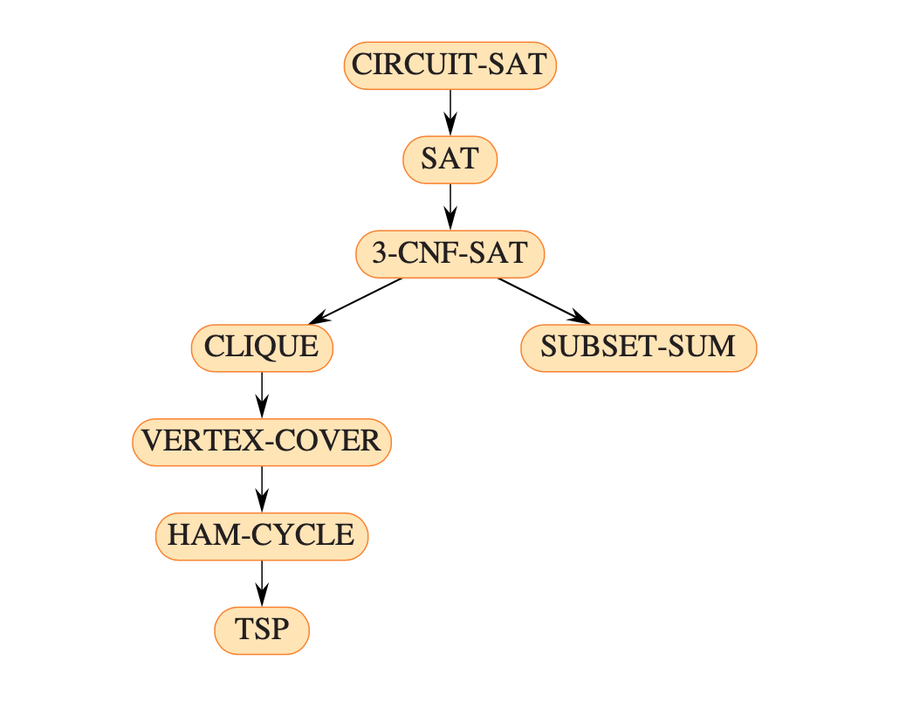
Reduction Method
The figure below outlines the structure of the NP-completeness proofs.
We can prove each language in the figure to be NP-complete by reduction from the language that points to it.
We will cover some of the problems in the next
session

Slide 49
Exercises
21
Search about 3-CNF Satisfiability problem.
Proof that 3-CNF Satisfiability belongs to class NP-complete. (You can do reduction using Satisfiability problem in previous slide)

Slide 50
References
Thomas H. Cormen. (2022). Introduction to algorithms: Fourth edition. The MIT Press. Chapter 34.

Slide 51
Thank you
NP-Completeness
September, 2023

